Slide 1
PrIde – Private Identity
Group 8 – Aishwarya Rastogi, Ronak Shah, Samkit Sheth, Siddhant Sribhashyam

Slide 2
Problem
Identity credentials have problem of security and privacy.
If its paper – based, its subject to loss, theft or fraud.
If its digital and on a centralized server, it can be hacked, leaked or manipulated.
Several Industries suffer the problems of current identity management systems like –
Governments, Banking, Education, Healthcare.
Problem of revealing more information than required to prove something.

Slide 3
Solution and Motivation
We intend to empower individuals and organizations with private and secure identity management service which runs on decentralized blockchain.
Organizations like DMV, Universities, etc can issue credentials to individuals on the blockchain using our solution
Individuals can manage their credentials securely on our system.
Verifying Organizations can be confident of the verification process and authenticity of the identity credentials even though less information is being revealed.

Slide 4
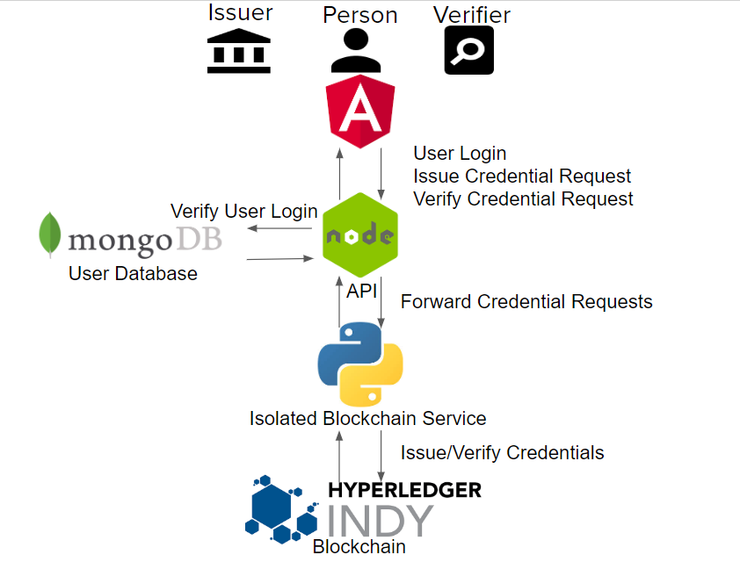
Architecture Diagram

Slide 5
Major Components
HyperLedger Indy
Blockchain Server
PrIde API
User Database
Frontend Application.

Slide 6
Crucial Concepts Implemented
Zero Knowledge Proofs
A Zero-Knowledge Proof consists of using cryptography for authentication in such a way that allows one entity to prove to another entity that they know a certain information or meet a certain requirement without having to disclose any of the actual information that supports that proof.
Self Sovereign Identity
Self-sovereign identity (SSI) is a term used to describe the digital movement that recognizes an individual should own and control their identity without the intervening administrative authorities.

Slide 7
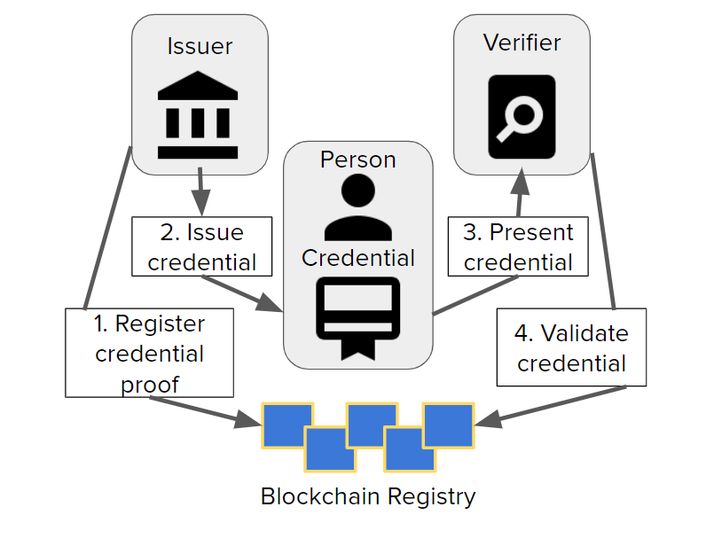
Workflow Diagram

Slide 8
Future Scope
Different view can be created for a central credential schema issuing authority. Right now any of the issuing/verifying organizations can create schemas.
Mobile Application can be created in which QR code will be generated by individual for easy scanning and verification by verifier.
Create a user authentication system which fetches credentials from the blockchain, without relying on any centralized authentication service.

Slide 9
Project Learning Outcomes
We got to learn many concepts from this project like Blockchain, Zero Knowledge Proofs, Docker Containerization, NoSQL databases, etc.
We also got hands on experience on various technologies and methodologies like Node, Angular, Python, Hyperledger.
We also learnt about the various aspects of product development lifecycle.

